Slide 1
Module 5: Sampling
5.3: Essentials of sampling, asking, and observing
Annie Collins
Data Sciences Institute, University of Toronto

Slide 2
Learning Outcomes
What makes a good sample, survey, and study? How does sampling theory differ from sampling in practice?
Identify characteristics of a good sample, and sampling approaches that will produce these characteristics.
Identify characteristics of good survey and questionnaire design.

Slide 3

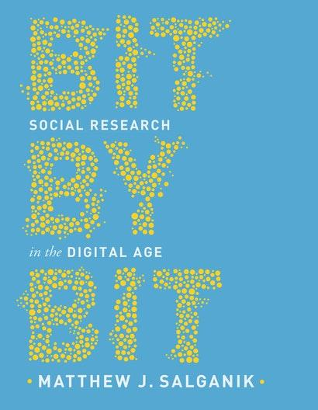
Key Texts
Lohr, 2019, Sampling Design and Analysis, 2nd Edition, CRC Press, Chapter 1
Salganik, 2018, Bit by Bit: Social research in the Digital Age, Chapter 3
Image sources: Sharon Lohr, Princeton University Press

Slide 4
Requirements of a Good Sample

Slide 5
Requirements of a Good Sample
Ideally the sampled population would be the same as the target population, however this is rarely the case
In a representative sample, the characteristics of the sampled population match the characteristics of the target population
Representation issues can arise at all stages of the study design and sampling process

Slide 6
Adapted from Lohr (2019), Figure 1.1
Target Population
Sampling Frame Population
Not reachable
Not included in sampling frame
Refuse to respond
Not eligible for survey
Sample
Not capable of responding
Notes:
Note: this figure was included in Section 5.2 slides as well, but has now been coloured to represent different groups of individuals

Slide 7
Target Population
Sampling Frame Population
Not reachable
Not included in sampling frame
Not capable of responding
Sample
Not eligible for survey
Refuse to respond
We want the characteristics of the sample to match the characteristics of the target population.
For this to be true, all of the following need to match the characteristics of the target population as well:
Individuals in the sampling frame
Individuals excluded from the sampling frame
Non-respondents
Individuals not eligible for the survey must be well defined, distinct from the target population, and properly excluded from analysis

Slide 8
Probability Sampling

Slide 9
Probability Sampling In Theory
Individuals have a chance of of being sampled
The probability of being sampled is known for each individual
All sampled individuals respond to the survey, or non-response is random
Analysis is straightforward
Estimates are accurate and precise

Slide 10
Probability Sampling in Practice
Some non-response is inevitable
Non-response is often biased
Non-response rates are increasing overall
Results depend on methods that researchers use to adjust for non response

Slide 11
Non-Probability Sampling
Benefits
Improved response rates
Faster
Cheaper
Drawbacks
Sampling unit selection probabilities are unknown, and not guaranteed to be non-zero
More difficult to produce accurate estimates for the target population

Slide 12
Questionnaire Design

Slide 13
Questionnaire Design
Section 1.5, Lohr, 2019
Always test your questions
Keep it simple and clear
Use specific questions instead of general ones, if possible
Relate your questions to the concept of interest
Notes:
Slides intentionally left sparse; elaborate from notes in Lohr (2019) Section 1.5

Slide 14
Questionnaire Design
Decide whether to use open or closed questions
Report the actual question asked
Avoid questions that prompt or motivate the respondent to say what you would like to hear
Consider the social desirability of responses to questions, and write questions that elicit honest responses
Notes:
Slides intentionally left sparse; elaborate from notes in Lohr (2019) Section 1.5

Slide 15
Questionnaire Design
Avoid double negatives
Use forced-choice, rather than agree/disagree questions
Ask only one concept per question
Pay attention to question order effects
Notes:
Slides intentionally left sparse; elaborate from notes in Lohr (2019) Section 1.5

Slide 16
Types of Questions
Open questions allow respondents to choose the format and content of their own response.
Closed questions have respondents choose from a predetermined group of responses (i.e. multiple choice, “Select all that apply”)
Leading questions prompt respondents into choosing or stating a specific (desired) response
Double-barreled questions contain more than one subject that may elicit conflicting opinions from a respondent

Slide 17
Observational Studies

Slide 18
Asking versus Observing
Surveys and observational studies have different strengths
Observational data has certain advantages over surveys:
High “response rate”
Observations do not depend on interpretations of questions or potentially flawed self-reported measurements
Data sets are often large

Slide 19
Asking versus Observing
Surveying is useful even in the presence of large observational data sources
Many observational data sources contain inaccuracies or are incomplete
Key qualitative traits like emotions, opinions, or knowledge are difficult to assess through observational studies
Surveying and observational data can often be complementary and provide great insight when used together

Slide 20
Surveys Linked to Observation Data Sources
Enriched asking: big data set is missing certain measurements, which are then collected by surveying and linked to the original data
Record linkage can be difficult
Quality of original data source may be difficult to assess
Amplified asking: researcher trains a prediction model using survey data collected from a small number of respondents plus their corresponding records from a big data set, then uses the model to predict responses to survey questions for all individual records in the original data set
Faster and cheaper than large-scale surveys
However, currently lacks strong theoretical basis

Slide 21
Next
5.4 Errors

